Slide 1
WEB RESOURCES and APPLICATIONS
Jessica Unger Foundation of the American Institute for Conservation of Historic and Artistic Works
Notes:
Today I’ll be going over just a few of the web-based and mobile resources that you can use to help prepare for and respond to emergencies and disasters. This is by no means an exhaustive list, but hopefully you’ll leave this session with at least a few ideas about how to harass technology to boost your preparedness efforts.

Slide 2
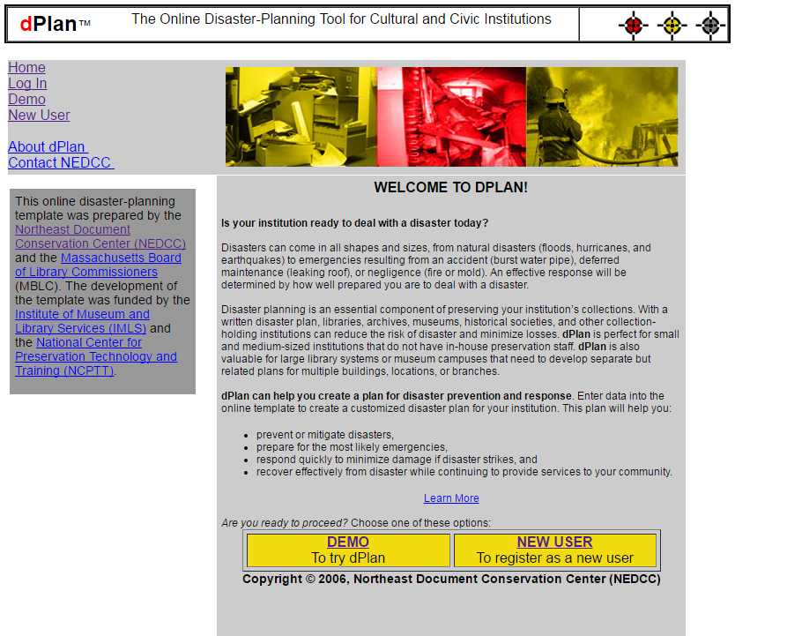
www.dplan.org
Notes:
Many of you might already be familiar with dPlan, a slightly older resource that nevertheless has proven to be an effective tool. It is available for free at dPlan.org, and it walks you through the process of developing a disaster plan. With a fairly straightforward interface, you can simply enter information about your institution into the program, and it will produce a custom disaster plan.
dPlan was prepared by Northeast Document Conservation Center (NEDCC) and the Massachusetts Board of Library Commissioners (MBLC). Template development was funded by the National Center for Preservation Technology and Training (NCPTT) and the Institute of Museum and Library Services (IMLS).
This is a great place to start if you don’t have a disaster plan in place.

Slide 3
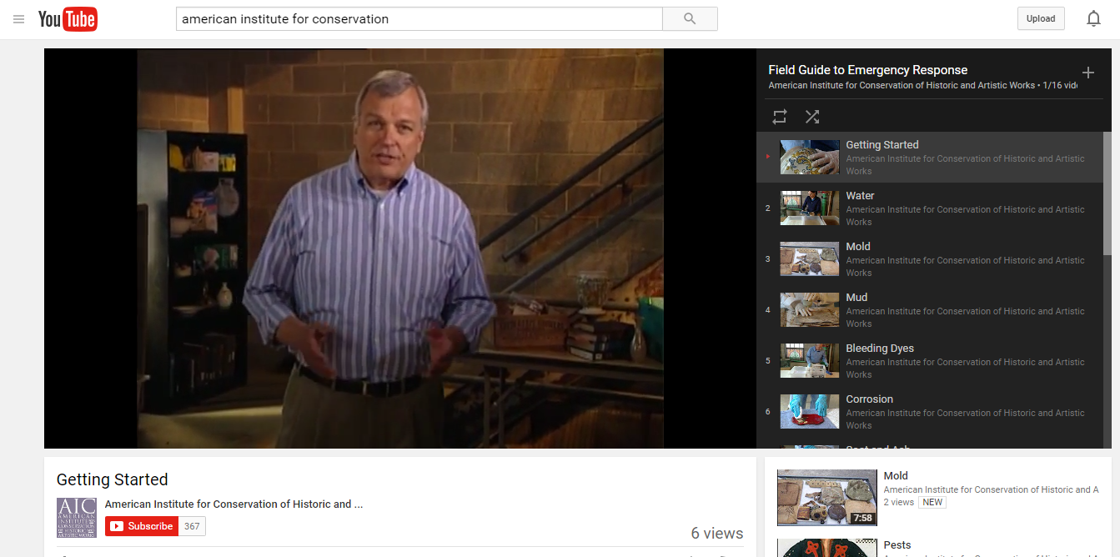
http://tinyurl.com/fieldguidevideos
Notes:
Today we’ve learned from Ann Frellsen about some of the principles of salvaging collections. One of the best ways to learn about this type of response is to see it in action. The Field Guide to Emergency Response is a resource originally created by Heritage Preservation and now under the copyright of FAIC. The guide is a printed book, but it also includes a DVD on salvage. These videos are now available to view for free on the AIC YouTube channel. Go to tinyurl.com/fieldguidevideos to watch the full series. Videos include:
Getting Started
Water
Mold
Mud
Bleeding Dyes
Corrosion
Soot and Ash
Broken Objects
Pests
Hazardous Materials

Slide 4
www.redcross.org/mobile-apps
Notes:
Moving on to applications. I highly recommend that everyone explore the mobile offerings from the American Red Cross. These programs are updated frequently, and include straightforward pieces of advice on how to handle emergencies.
First Aid by American Red Cross provides free lifesaving first aid instruction and disaster preparedness information, including videos, interactive quizzes and simple step-by-step advice.
Red Cross Emergency is an “all-inclusive” app that combines more than 35 different severe weather and emergency alerts from natural to man-made, giving users real-time information about incidents that are about to occur in their location.
Earthquake - American Red Cross app provides step-by-step instructions on what to do before/during/after an earthquake. It also includes an "I'm Safe" feature to notify family and friends that you are okay.
Flood by American Red Cross app provides flood warning alerts, location of open shelters, information about dealing with floods and power outages and a customizable "I'm Safe" notification.
Hurricane by American Red Cross app provides access to local and real time information on what to do before, during and after hurricanes, including an "I'm safe" messaging alert.
Tornado by American Red Cross app provides access to local and real time information on what to do before, during and after a tornado, including an audible siren when NOAA issues a tornado warning even if your app is closed.
Wildfires by American Red Cross shows where NOAA has issued wildfire warnings, notifies you when a new wildfire occurs and gives you a current view of the wildfire's track and perimeter. You can also let loved ones know that you are safe even if the power is out and learn what steps you should take to prepare your family, home and pets.

Slide 5
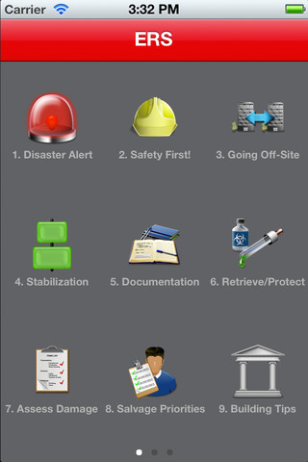
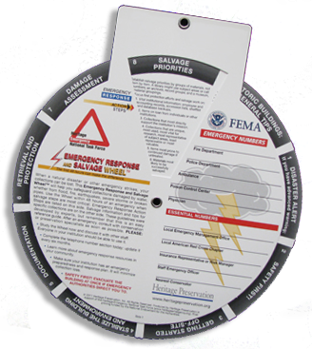
www.conservation-us.org/emergencies/ers-app
Notes:
Quick show of hands: how many of you are familiar with the Emergency Response and Salvage Wheel? How many knew there was a free app?
Emergency Response and Salvage Wheel has been used by museums, libraries, and archives around the world. The mobile app makes the Wheel's invaluable guidance accessible to anyone who is in need of practical advice for saving collections in the first 48 hours after disaster strikes.
The app provides the same reliable content found in the original Wheel, outlining critical stages of disaster response and provides practical salvage tips for nine types of collections, from photographs to natural history specimens.
This information can help users protect precious collections and significant records, access reliable information instantly, and save damaged objects. The app was created in partnership with the National Center for Preservation Technology and Training.

Slide 6
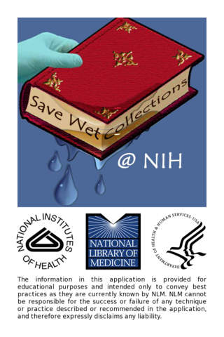
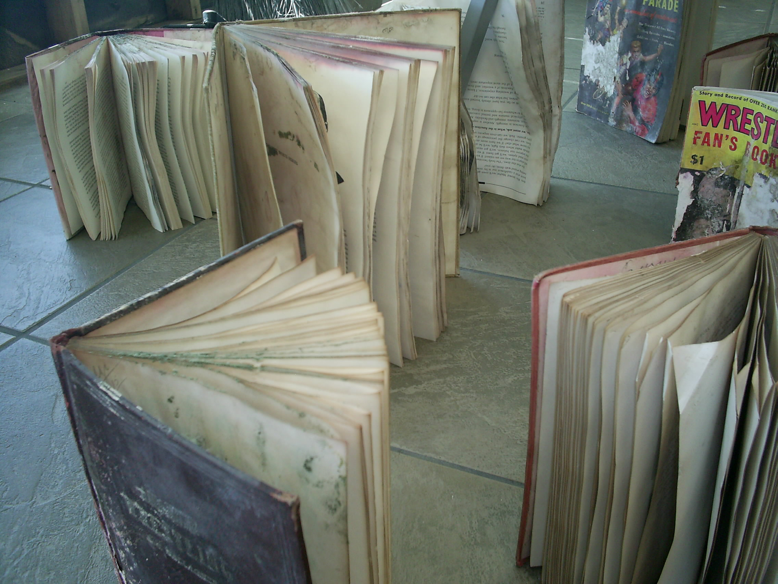
sis.nlm.nih.gov/dimrc/disasterapps.html
Notes:
The National Library of Medicine at the National Institutes of Health developed an application called “Library Floods” which covers basic steps for recovering collections after a water emergency. There are specific instructions for different types of materials, as well as information on health and safety.

Slide 7
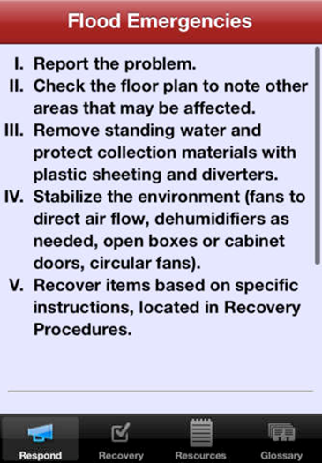
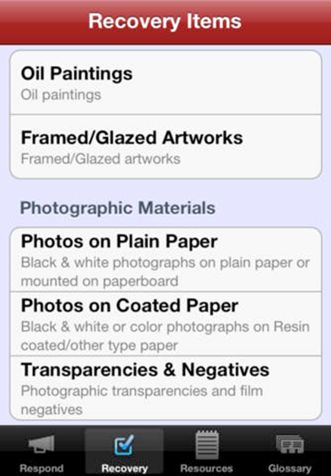
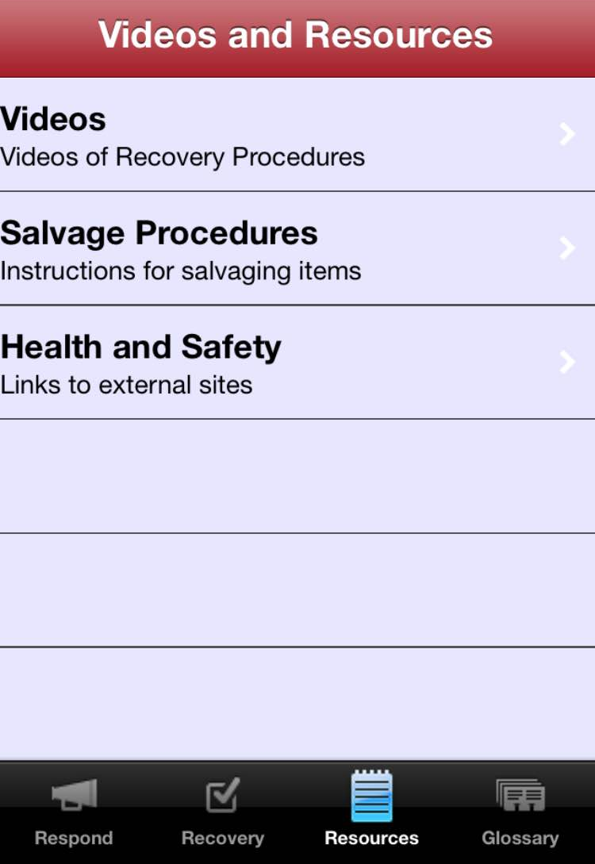
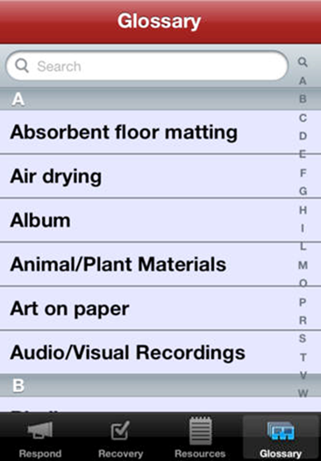
sis.nlm.nih.gov/dimrc/disasterapps.html
Notes:
Once you enter the app, you’ll find information on response, recovery, a list of videos and resources, and a glossary of terms.

Slide 8
sis.nlm.nih.gov/dimrc/disasterapps.html
Notes:
This fall, the videos under the “resources” section will be updated. Clips from the Field Guide videos, previously shared, will be available to view in this section of the app.

Slide 9
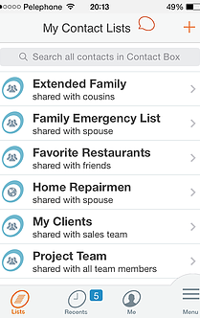
www.contactbox.mobi
Notes:
I also want to encourage you to explore apps that help with the process of staying in touch. There are several options for apps that will organize emergency contact lists (which, by the way, should be the backbone of any effective emergency plan). I have ContactBox on my phone – it’s an easy way to build lists and then share those lists with others. It also allows you to easily send group messages – either via text or email. But, as I said, there are many (free) options on the market, so see what works best for you.

Slide 10
Contact Me
Jessica Unger | Emergency Programs Coordinator
junger@conservation-us.org
t 202-661-8069 | f 202-452-9328
www.conservation-us.org | @conservators
FAIC
FOUNDATION of the AMERICAN INSTITUTE FOR CONSERVATION
1156 15th St., NW | Suite 320 | Washington, DC | 20005
Notes:
This was just a whirlwind tour of some of the web and mobile disaster resources available to you and your institution. Please refer to the handout for a list of the urls mentioned during the presentation. I’m more than happy to answer any questions, so feel free to get in touch!

